Slide 1
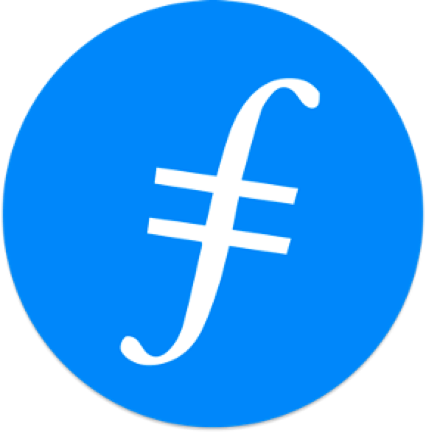



Chapter 4:
The History of Ethereum
Beginners Guide to Filecoin
Content created by Brown Zhang
Researcher @ KEN Labs

Slide 2

Ethereum is a decentralized blockchain with smart contract functionality.
Ethereum

Slide 3

History
Ethereum was initially described in late 2013 in a white paper by Vitalik Buterin, a programmer and co-founder of Bitcoin Magazine, that described a way to build decentralized applications.
Ethereum was announced at the North American Bitcoin Conference in Miami, in January 2014.
Buterin chose the name Ethereum as it sounded nice and it had the word 'ether', referring to the hypothetical invisible medium that permeates the universe and allows light to travel.

Slide 4

Development (2014)
2014 is the year of Ethereum Development.
Formal development of the software underlying Ethereum began in early 2014 through a Swiss company, Ethereum Switzerland GmbH. The idea of putting executable smart contracts in the blockchain needed to be specified before it could be implemented in software.
This work was done by Gavin Wood, then the chief technology officer, in the Ethereum Yellow Paper that specified the Ethereum Virtual Machine.
Subsequently, a Swiss non-profit foundation, the Ethereum Foundation was founded.

Slide 5
Launch and the DAO event (2014–2016)
Several codenamed prototypes of Ethereum were developed over 18 months in 2014 and 2015 by the Ethereum Foundation as part of their proof-of-concept series. "Olympic" was the last prototype and public beta pre-release. The Olympic network gave users a bug bounty of 25,000 ether for stress-testing the Ethereum blockchain.
On 30 July 2015, "Frontier" marked the official launch of the Ethereum platform, and Ethereum created its "genesis block". The genesis block contained 8,893 transactions allocating various amounts of ether to different addresses, and a block reward of 5 ETH.
Since the initial launch, Ethereum has undergone a number of planned protocol upgrades, which are important changes affecting the underlying functionality and/or incentive structures of the platform. Protocol upgrades are accomplished by means of a hard fork.

Slide 6
Launch and the DAO event (2014–2016)
In 2016, a decentralized autonomous organization called The DAO—a set of smart contracts developed on the platform—raised a record US$150 million in a crowd sale to fund the project. The DAO was exploited in June 2016 when US$50 million of DAO tokens were stolen by an unknown hacker. The event sparked a debate in the crypto-community about whether Ethereum should perform a contentious "hard fork" to reappropriate the affected funds.
The fork resulted in the network splitting into two blockchains:
Ethereum with theft reversed, and Ethereum Classic, which continued on the original chain.
The hard fork created a rivalry between the two networks. After the hard fork, Ethereum subsequently forked twice in the fourth quarter of 2016 to deal with other attacks.

Slide 7
Continued development and milestones (2017–present)
In March 2017, various blockchain startups, research groups, and Fortune 500 companies announced the creation of the Enterprise Ethereum Alliance (EEA) with 30 founding members.
By January 2018, ether was the second-largest cryptocurrency in terms of market capitalization, behind bitcoin.
After the Constantinople upgrade on 28 February 2019, there were two network upgrades made within a month late in the year: Istanbul on 8 December 2019 and Muir Glacier on 2 January 2020.
There were two network upgrades in 2021.
The first was "Berlin", implemented on 14 April 2021.
The second was "London", which took effect on 5 August.

Slide 8
Ethereum 2.0
Ethereum 2.0 (Eth2) was a set of three or more upgrades, also known as "phases", meant to transition the network's consensus mechanism to proof-of-stake, and to scale the network's transaction throughput with execution sharding and improved EVM architecture.
First: "phase 0", launched the proof-of-stake Beacon Chain on the 1st of December, 2020.
In early 2022, the “Ethereum 2.0” terminology was deprecated in an effort to highlight the existence of only one Ethereum network and one ether cryptocurrency. The Eth1 blockchain was renamed to the “execution layer”, and its associated Eth1 clients were reclassified as execution clients. Similarly, the Eth2 blockchain was renamed to the "consensus layer", and its associated Eth2 clients were reclassified as consensus clients.
On 15 September 2022, Ethereum transitioned its consensus mechanism from proof-of-work (PoW) to proof-of-stake (PoS) in an upgrade process known as "the Merge". This has cut Ethereum's energy usage by 99%.

Slide 9
Design
Ether (ETH): The cryptocurrency generated in accordance with the Ethereum protocol as a reward to validators in a proof-of-stake system for adding blocks to the blockchain.
Accounts: Two types of accounts: user accounts and contracts. Both types have an ETH balance, may send ETH to any account, may call any public function of a contract or create a new contract, and are identified on the blockchain and in the state by an account address.
Address: Ethereum addresses are composed of the prefix "0x" (a common identifier for hexadecimal) concatenated with the rightmost 20 bytes of the Keccak-256 hash of the ECDSA public key.
Ethereum Virtual Machine (EVM): The runtime environment for transaction execution in Ethereum.
Gas: A unit of account within the EVM used in the calculation of the transaction fee.

Slide 10
Applications
Ethereum allows anyone to deploy permanent and immutable decentralized applications onto it, with which users can interact. Decentralized finance (DeFi) applications provide a broad array of financial services without the need for typical financial intermediaries like brokerages, exchanges, or banks, such as allowing cryptocurrency users to borrow against their holdings or lend them out for interest.
Ethereum also allows users to create and exchange NFTs, which are unique tokens representing ownership of an associated asset or privilege, as recognized by any number of institutions.
Additionally, many other cryptocurrencies utilize the ERC-20 token standard on top of the Ethereum blockchain and have utilized the platform for initial coin offerings.

Slide 11
Applications
Here are the most famous and essential applications built on Ethereum:
Contract source code: Ethereum's smart contracts are written in high-level programming languages and then compiled down to EVM bytecode and deployed to the Ethereum blockchain.
ERC-20 tokens: The ERC-20 Token Standard allows for fungible tokens on the Ethereum blockchain.
Non-fungible tokens (NFTs): Ethereum also allows for the creation of unique and indivisible tokens, called non-fungible tokens (NFTs).
Decentralized finance: Decentralized finance (DeFi) offers traditional financial instruments in a decentralized architecture, outside of companies' and governments' control.

Slide 12
Conclusion
The history and application of Ethereum was shown above.
Brought the whole picture of Ethereum.

Slide 13

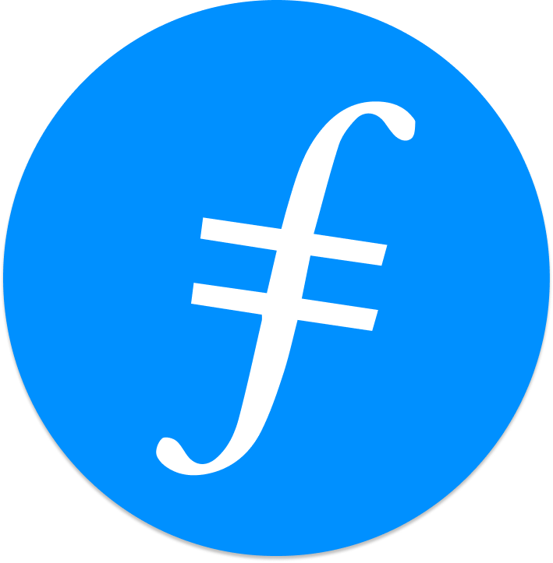
Feedback is welcomed.
https://github.com/kenlabs/Beginners-Guide-to-Filecoin

